Slide 1












Joint Presentation on Bushmeat Pilot Project Implementation by USFWS
MENTOR Fellows
Peter Amum, Isaac Seme, Lowaeli Damalu, Andmile Martin, Evanson Kariuki, Iregi Mwenja, Okello Genesis and Vincent Opyene

Slide 2
Awareness Activities in Boma and Bandingalo National Parks and at the National Level in
Southern Sudan
Peter Amum and Isaac Seme
MENTOR Fellows-Southern Sudan
Email: p_amum@yahoo.com

Slide 3

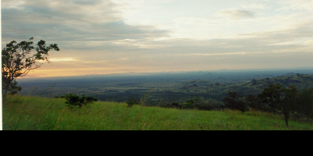
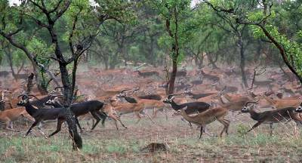

Introduction
Southern Sudan Richness
Habitats
Biodiversity
  Plants
  Animals
    938 species of birds
    266 species of mammals
    120 species of fish
  Endemism
  Globally rare and/
  or endangered species

Slide 4
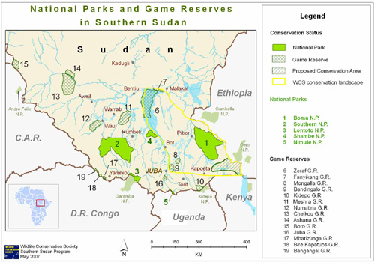
Map: Southern Sudan
5 National Parks & 14 Game Reserves
peter
2

Slide 5
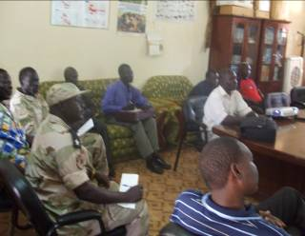
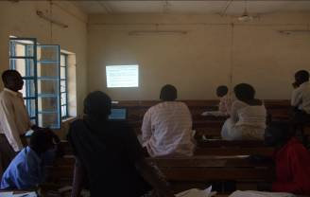
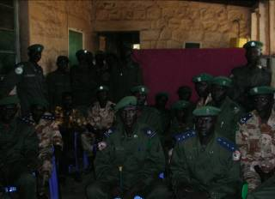
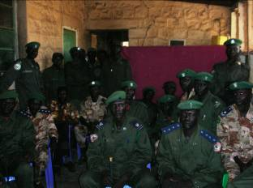
Objectives and Methods
Objectives for Southern Sudan
  Raise awareness, improve law enforcement capacity and build partnership
Methods
  Adaptive Management
  Meetings
  Media
  Film show
  T-Shirt

Slide 6
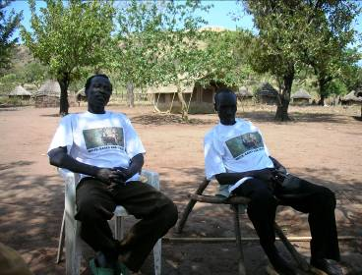
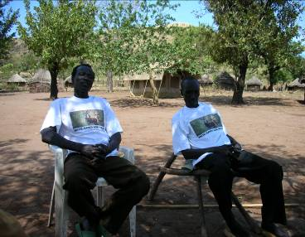
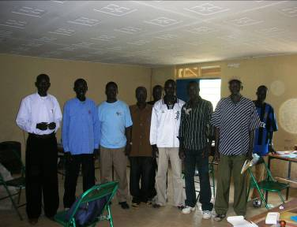
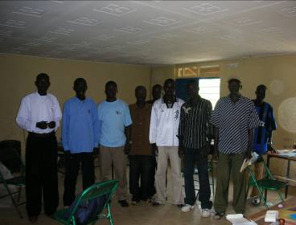
Boma, Bor, & Bandinglo
National Parks
Target groups
Chiefs
Teachers
Religious leaders
Teachers Training Institute
Rangers Training Institute
Students both Senior, Primary
Adult education
Wildlife authority
Police forces
Local administration

Slide 7
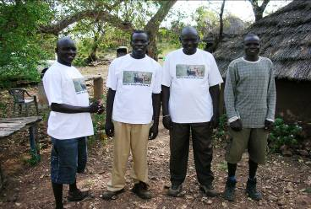
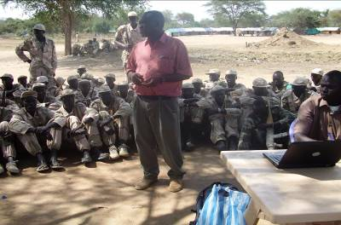
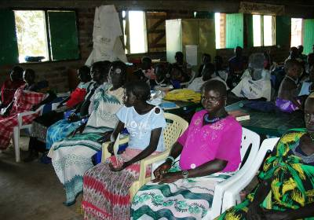
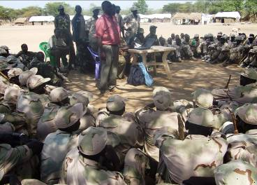
Boma, Bor & Bandinglo
National Parks

Slide 8
Key Accomplishments
Fostered partnership with WCS, USDA, MWCT, NPA, & USAID.
800 wildlife forces were engaged in bushmeat issues.
Five articles on bushmeat were published.
Five poachers arrested in Bor with five guns that resulted in
several articles over Southern Sudan media.
14 trucks donated by GOSS to the MWCT for anti poaching.
Teachers Training Institute willing to form partnership to
include bushmeat issue in the curriculum.
Teachers committed to include bushmeat issues in syllabus, establish wildlife club, and include Roots and Shoots program
in planting tree in the school.

Slide 9
Recommendations
Bushmeat curriculum development in Southern Sudan as an effective conservation education tool to address bushmeat issue.
Secure one development agency and private sector to promote protein/income alternative to reduce pressure on wildlife species.
Partnership building is essential approach for bushmeat solution.
Review of wildlife policies and laws.

Slide 10
Protein Alternatives and Law Enforcement Partnership in Serengeti Ecosystem,Tanzania
Lowaeli S. Damalu and Andimile Martin
MENTOR Fellows-Tanzania
Email: lowaeli@yahoo.co.uk

Slide 11

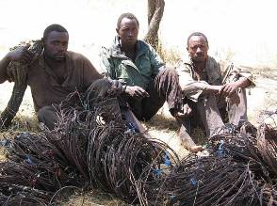
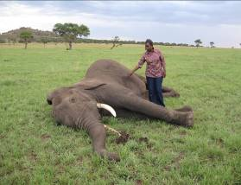
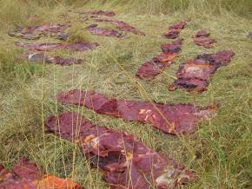
Background
Wildlife in Tanzania provides unique natural heritage and resources;
About 24% of total land surface set aside as wildlife protected areas.
Serengeti ecosystem is one of the most important in the country
Courtesy: TANAPA rangers

Slide 12
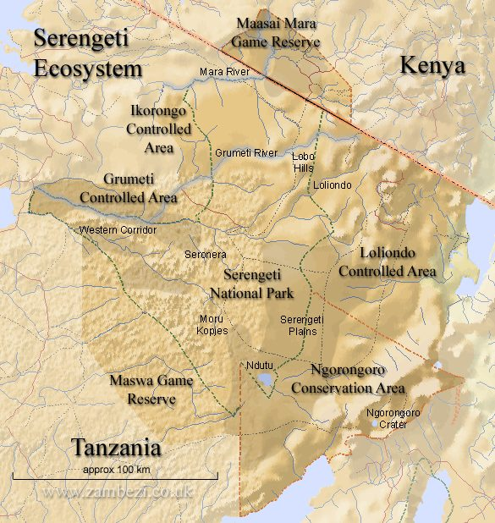
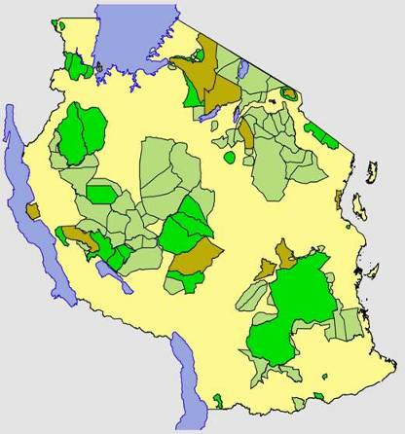
Serengeti Ecosystem , Tanzania
Total area :27,000 sq.kms
Also include 2 WMAs and Village lands
SENAPA, NCA, Grumeti,Ikorongo & , Maswa Game Reserve and Loliondo G.C.A

Slide 13

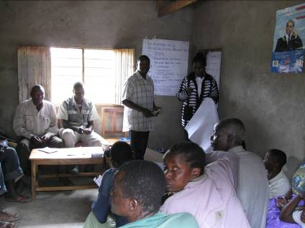
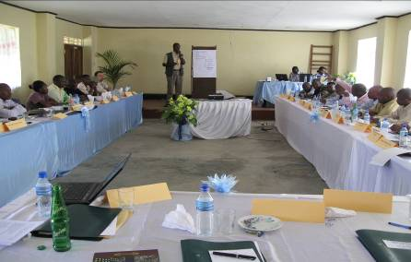
Objectives & Methods
Protein alternatives
Improve law enforcement
Build partnership
Plan for implementation
Adaptive Management
More than 25 meetings
One workshop
Notes:
By May, 2009 there will be commitment to working in partnership to develop/expand protein alternatives to at least six villages in Serengeti Ecosystem.
By May, 2009 at least one training workshop will be completed to build partnership among law enforcement professionals and increase capacity to increase wildlife crime prosecution in two courts around Serengeti ecosystem
By May, 2009 the Serengeti ecosystem as one of identified key protected area in Eastern Africa should have a functional public-private-government partnership that is directly addressing bushmeat hunting and trade.

Slide 14
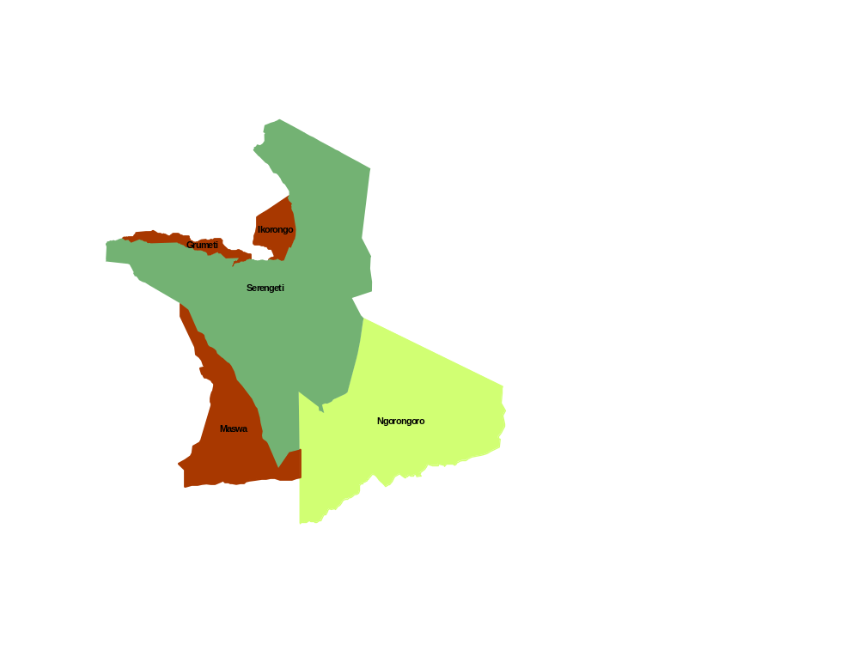
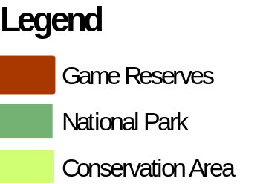
Key Achievements
Protein alternative:
Six villages in western
Serengeti ecosystem were
selected
Priority protein alternatives
identified: goats; chickens; fish
and piggery
Some protein alternative projects exist – Natta Village (piggery, chicken and fish farming)
Key partners promised to support
Pilot villages
village

Slide 15
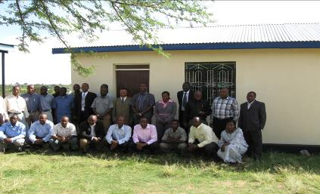
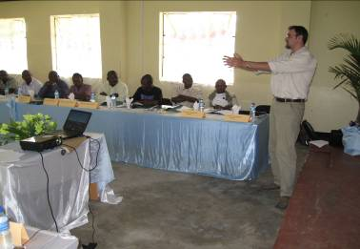
Law Enforcement
One training workshop drew 35 officers from 11 different institutions
Participants trained in various wildlife case handling
Five non practising wildlife prosecutors synthesized. Now prosecuting.

Slide 16
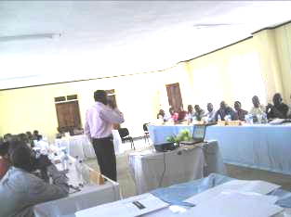
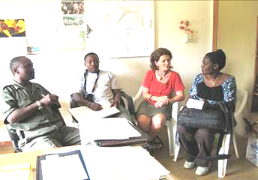
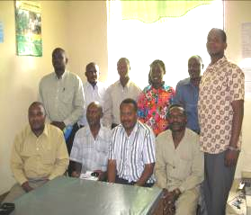
Partnership building
Partnership initiatives in place - Serengeti Ecosystem Forum (SEF)
The Draft MOU to be revised to include bushmeat solutions
MNRT agreed to incorporate some of bushmeat solutions into their Publicity/awareness programs

Slide 17

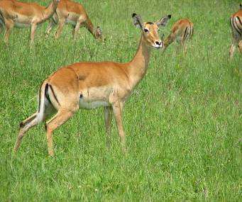
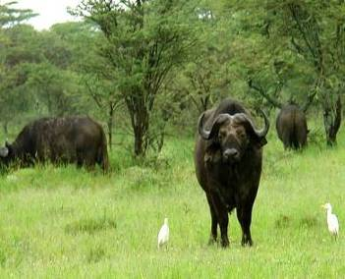
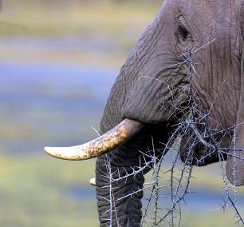
Recommendations
Networking and Collaboration
Increased awareness on impact of bushmeat consumption
Partners to fulfill their promises to implement bushmeat solutions
More partners to support protein alternative projects in Serengeti Ecosystem
Enhance wildlife law enforcement

Slide 18
Bushmeat Awareness Activities in Kenya and Partnership Experience in Masai Mara
Evanson J Kariuki and Iregi Mwenja
MENTOR Fellows - Kenya
Email: jmkevanson@yahoo.com

Slide 19
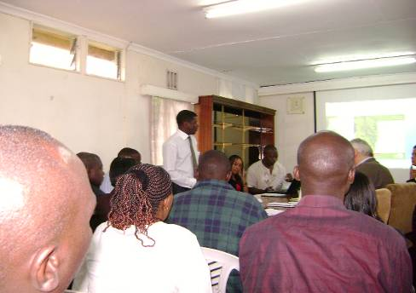
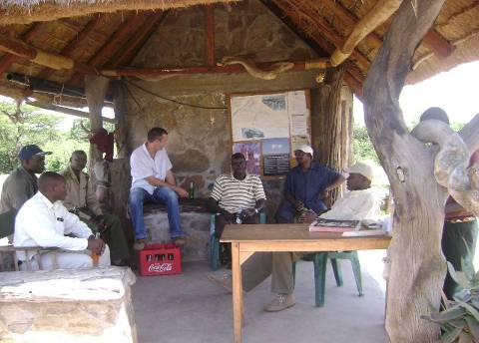
Objectives
To raise awareness, improve law enforcement,
build bushmeat information management systems and work with partnerships in Mara ecosystem
Notes:
Kenyan team , Kariuki, Dr Mwangi and Mwenja. Worked with Vincent on law enforcement.

Slide 20
Awareness accomplishments
Engaged head driver guides and board members of KPSGA on bushmeat issues
Took lead in creating and launching BEAN website with content and material contribution from all fellows
Got 4 articles were placed in popular media
Organized 1st bushmeat symposium for Kenya
Distributed communication materials to stakeholders and potential partners
Advised WCK and AFEW education officers
Notes:
Wildlife clubs of Kenya, Africa Fund for Endangered wildlife, Youth for Conservation

Slide 21

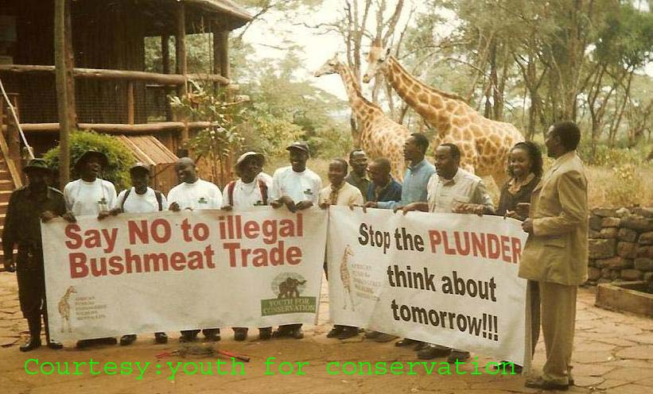
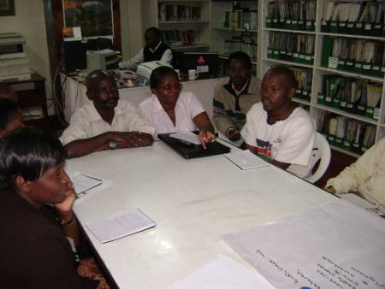
Posted 48 blog entries on bushmeat blog
Used social media to promote awareness, started a facebook cause: “Stop wildlife snaring”
Spread information about Ministry of Forestry and Wildlife new toll free line (08002212323) for reporting bushmeat incidents
Notes:
Bushmeat in Kenya Blog,

Slide 22
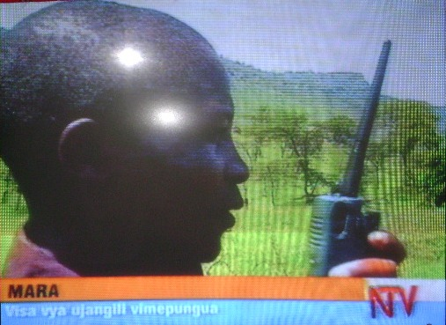
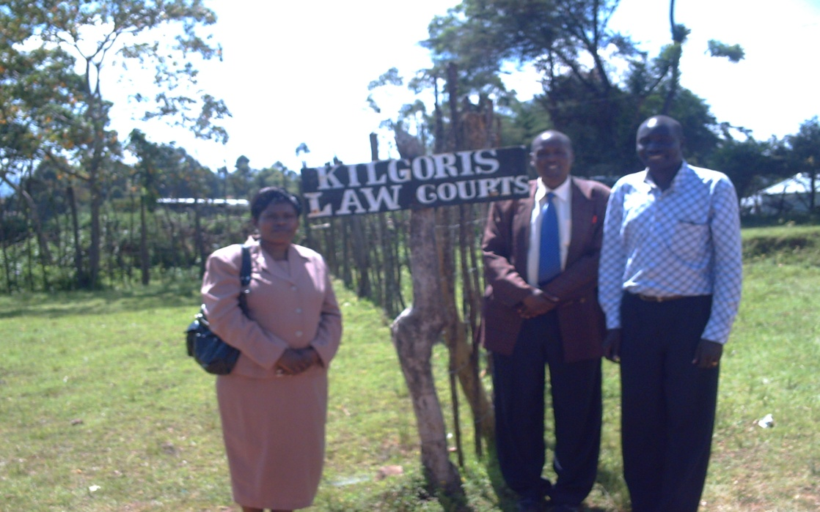
Highlighted community scouting in Mara in
NTV
Engaged chiefs, village elders, officials of conservancies and Mara discovery and community empowerment center on bushmeat
identified a cohort of wildlife club patrons who are willing to incorporate bushmeat awareness activities into club activities

Slide 23
Partnerships
1st bushmeat symposium for Kenya to
strengthen collaboration by providing a forum for information sharing and dialogue.
45 participants from 18 different govt and NGOs from across the country. Organizations included EAWLS, KWS, DSWT, NMK,USFWS MENTOR Program, Wildlifedirect Inc, USAID, AWF, ACC, Nation media, YFC, IPR, ANAW, UON, UNIDO, Soysambu Conservancy, and Birdwatching East Africa
Notes:
UNIDO- United Nations industrial development organisation

Slide 24
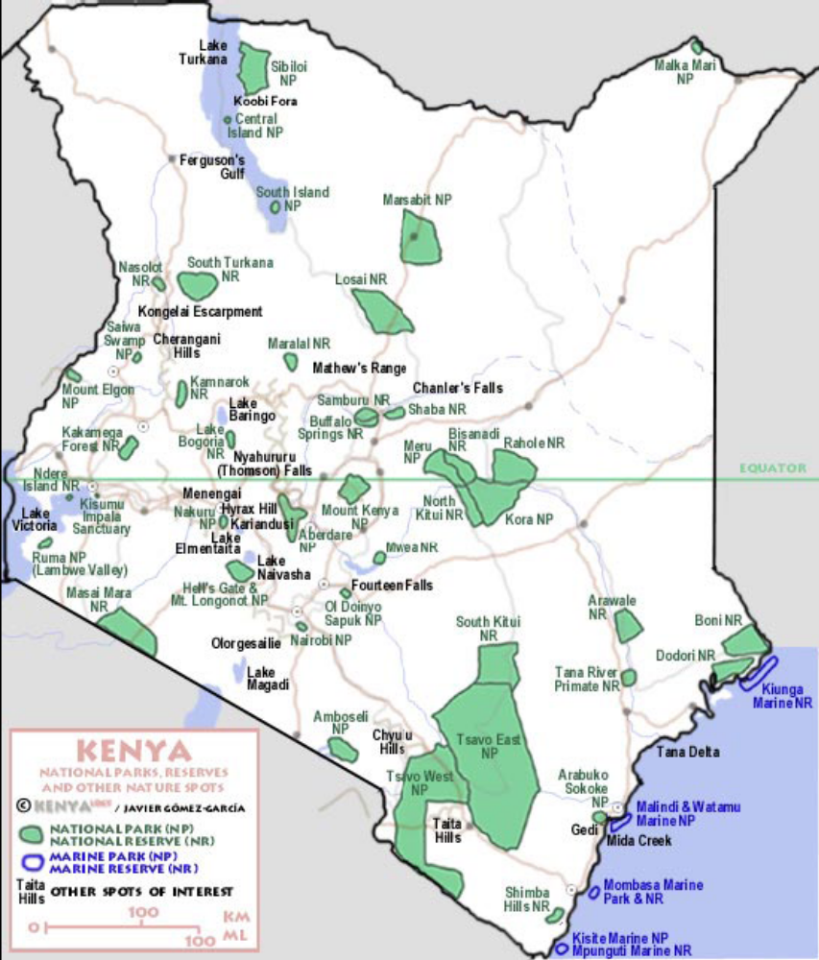
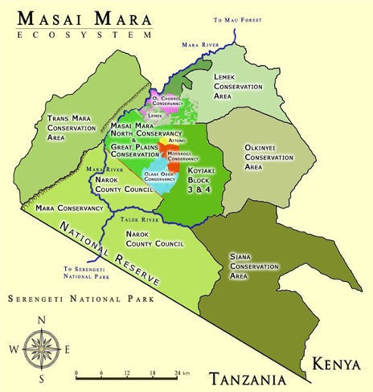
Map of Masai Mara
Maasai Mara

Slide 25
Partnership in Masai Mara
Meetings with MC the first public private sector mgt agreement for Kenya provided for by a ten-year mgt agreement between the MC and County Council of Trans Mara.
The MC has developed a model for cross border collaboration with SENAPA. working on law enforcement along the common border
Discussed partnership with Koiyaki Guiding and wilderness school
Partnered with NGOs and CBOS
Notes:
Mara conservancy. CFTW, AKTF, , Trans Mara game scouts association, Lepolosi Wildlife scouts, Dupoto wildlife association, Enkoirero scouts association

Slide 26
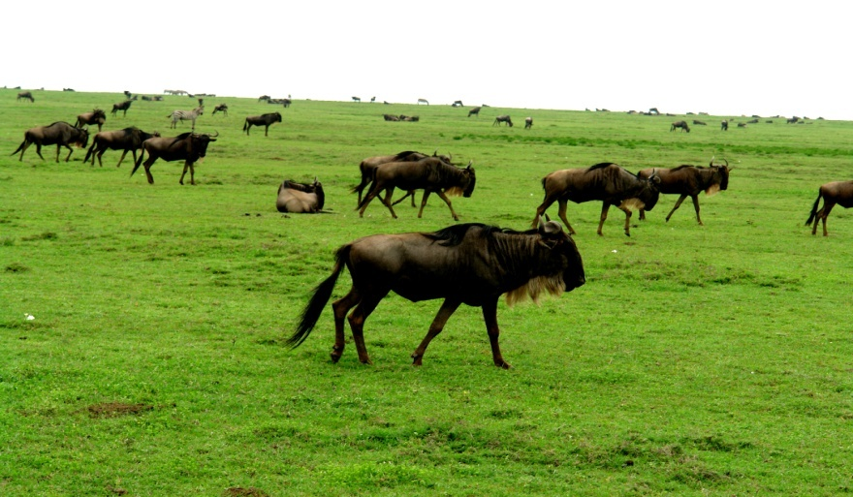
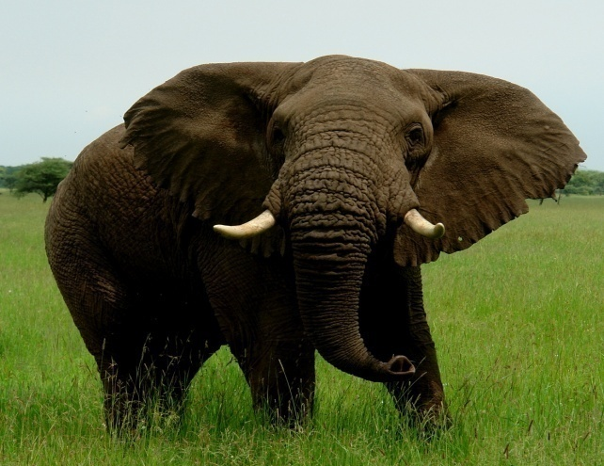
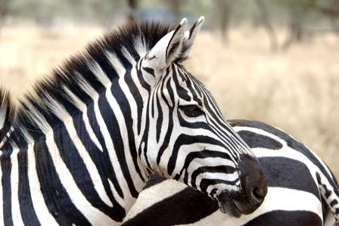
Arrest of 1,189 poachers, recovery of 10,500 snares, recovery of 150 stolen cattle, rescue of snared animals and made the MT and adjoining areas secure.
Tourism industry partnering with communities through the formation of conservancies. Leaseholders provide mgt and security. OOC, YIELE. patrol cars donated by A&K, and AKT.
Notes:
Olare Orok Conservancy, Yiele conservancy by Saruni camp

Slide 27
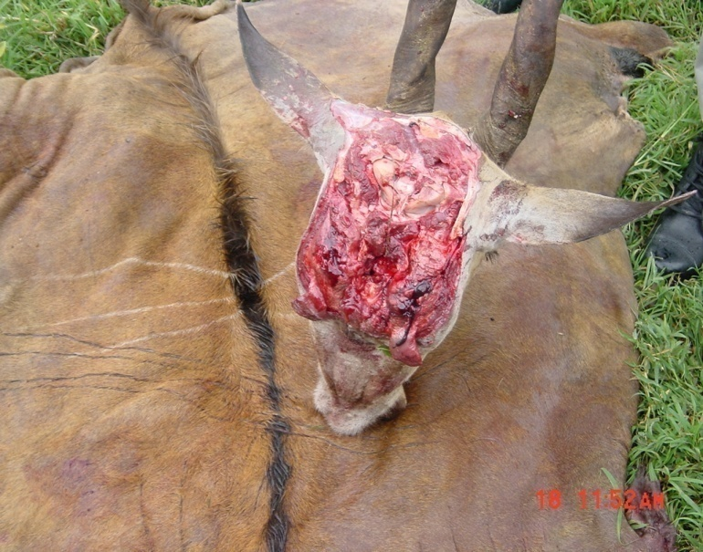
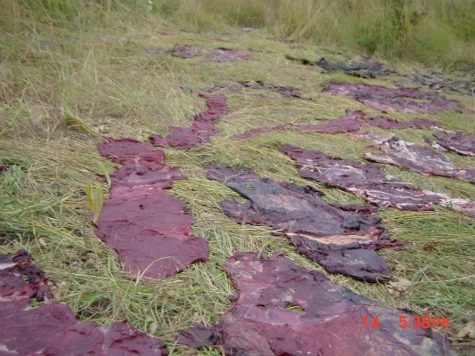
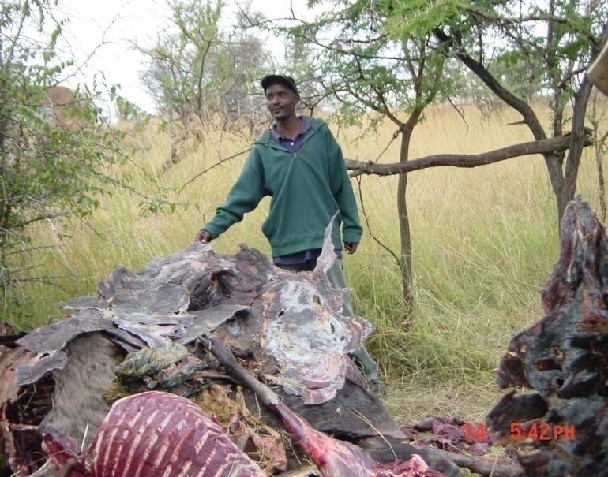
Recommendations
Production of bushmeat education materials for eastern Africa audiences.
Strengthen capacity for bushmeat monitoring
Promote partnerships that provide alternatives for income and protein to communities.
Improve law enforcement through partnerships

Slide 28
Alternative Income Generating Activities, Law Enforcement, Partnerships and Awareness Around Murchison Falls Conservation Area, Uganda
Okello Genesis and Vincent Opyene
MENTOR Fellows-Uganda
Email: okellogenesis@yahoo.com

Slide 29

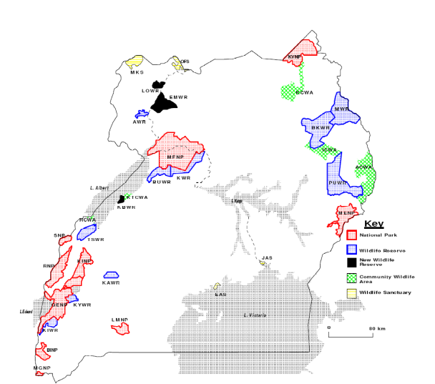
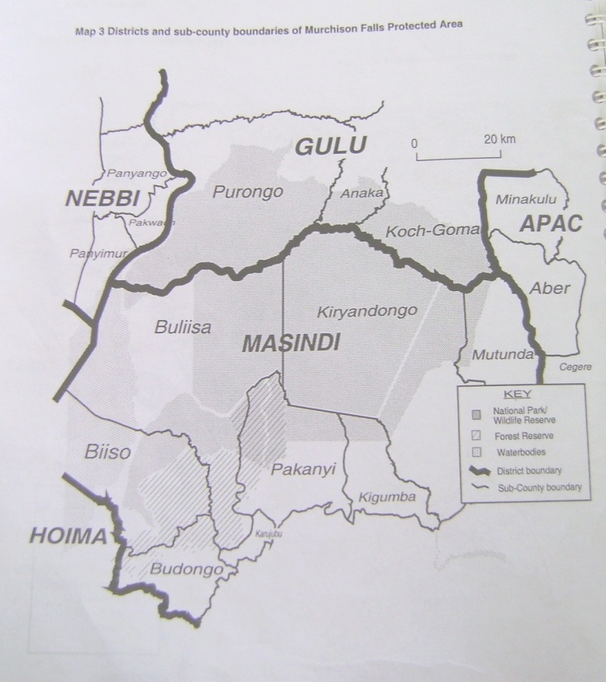
Introduction on Uganda
Over 53% of the Mountain Gorillas in the world
Over 1,000 Bird species (over 10% of global diversity)
Of 1,500 bird species in East Africa, 72% are found in Uganda
Over 7% of global mammal species diversity
Murchison Falls Conservation Area-largest, origin for most bushmeat

Slide 30
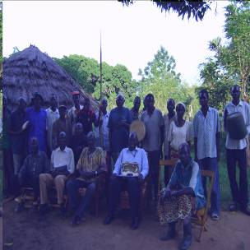
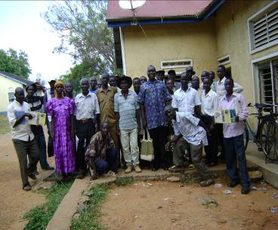

Goal and Objectives
By 2013, there will be a reduction in bushmeat off take in key protected areas of Eastern Africa due to increased capacity to effectively address the bushmeat problem
- Income alternatives
- Increased law enforcement
- Partnership
- Awareness

Slide 31



Accomplishments
Eligibility to RSF
Awareness (arrest and Problem animal)
Two groups : once a year
never
Hunting is on weekly basis/ hunt themselves
Species hunted: hippos, buffalo, Uganda kob
Main method of hunting: snaring

Slide 32



Team, Partnership and Support- Accomplishment
CARE, Media, UWA, Alur Kingdom, Jonam Cultural Chiefs,
Law enforcement personnel, the local CBOs, and UTODA
- Media reports: UWA Website
- Law enforcement workshop: The Link
- Cultural/Kingdom official : Agreed to work together
- 40 wire snares recovered and one giraffe rescued

Slide 33



Accomplishment on Alternative Income
Generating Activities (IGA)
One alternative IGA adopted(30 goats)
Two groups gain eligibility to MFNP- RSF
One association of poachers formed: paying $10 per annum and $1 per month
Turkey and guinea fouls for widows of poachers

Slide 34



Accomplishment on Awareness
44 spears surrendered to UWA, one associations of poachers formed
Meetings: Cultural Kings officials and cultural chiefs, executives of reformed poachers
More parishes showing interest in the program
Reports of illegal activities by the communities

Slide 35




Recommendations
Partnership.
Grow BEAN
Alternatives
Law enforcement technology-DNA
Awareness

Slide 36

www.bushmeatnetwork.org
www.mentorfellowshipprogram.org

